Slide 1
Rate Analysis by Parameter for Historic Accelerator Data
Nathan Schneider
schnei.Nathan@gmail.com

Slide 2
Project Requirements
Get rate of valid dust events per hour from database data
Obtain data directly from the MySQL database
Searchable by velocity range, dust material, specific dust IDs, date range, mass, and given experiment IDs
Graphical Interface for ease of use through LabVIEW

Slide 3
MySQL Stored Data
All 5.5 million dust detection events, w/ data and timestamps
Velocity Setting Changes with timestamps for the PSU (Particle Selector Unit)
Experiment ID with timestamps
Database run_times table has incorrect data past June 2014, correction needed going forward
Task was to find “active sessions” and calculate rates within them

Slide 4
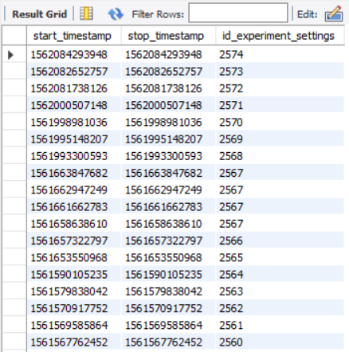
Problematic Approaches
Previously Attempted to define active sessions by stored and timestamped setting changes for the dust source, including needle voltage, frequency
These source settings had a five-minute delay between changes and backup to the database, meaning if the rest of the system was shut down before the backup, the settings were not saved to the database

Slide 5
Chosen Approach
Dust Event: Timestamp, velocity, estimate quality, dust ID
PSU setting change: Timestamp, velocity min, velocity max
Velocity: 6342m/s
Dust ID: 97
Estimate Quality: 4
ExpID: 265
Experiment change: Timestamp, experiment ID
ExpID: 266
V min: 5km/s
V max: 10km/s
V min: 30km/s
V max: 40km/s
The chosen approach is the segmentation of the total timeline along gaps between particle clusters, PSU setting changes, and experiment setting changes.

Slide 6
Chosen Approach
1: Split into group by first and last detection, given some gap length
20 Minutes

Slide 7
Chosen Approach
2: Tag and Segment based on velocity changes
V min: 5km/s
V max: 10km/s
V min: 30km/s
V max: 40km/s
V min: 5km/s
V max: 10km/s
V min: 5km/s
V max: 10km/s
V min: 30km/s
V max: 40km/s
V min: 30km/s
V max: 40km/s

Slide 8
Chosen Approach
3: Segment and Tag based on experiment changes
ExpID: 265
ExpID: 266
V min: 5km/s
V max: 10km/s
V min: 5km/s
V max: 10km/s
V min: 30km/s
V max: 40km/s
V min: 30km/s
V max: 40km/s
V min: 5km/s
V max: 10km/s
ExpID: 265
V min: 5km/s
V max: 10km/s
ExpID: 265
V min: 30km/s
V max: 40km/s
ExpID: 265
V min: 30km/s
V max: 40km/s
ExpID: 266
V min: 30km/s
V max: 40km/s
ExpID: 265

Slide 9
Chosen Approach
4: Tag sessions with dust type
Dust ID: 97
Dust ID: 97
Dust ID: 97
Dust ID: 87
Dust ID: 87
V min: 5km/s
V max: 10km/s
ExpID: 265
V min: 5km/s
V max: 10km/s
ExpID: 265
V min: 30km/s
V max: 40km/s
ExpID: 265
V min: 30km/s
V max: 40km/s
ExpID: 266
V min: 30km/s
V max: 40km/s
ExpID: 265
V min: 5km/s
V max: 10km/s
ExpID: 265
DustID: 97
V min: 5km/s
V max: 10km/s
ExpID: 265
DustID: 97
V min: 30km/s
V max: 40km/s
ExpID: 265
DustID: 97
V min: 30km/s
V max: 40km/s
ExpID: 265
DustID: 97
V min: 30km/s
V max: 40km/s
ExpID: 266
DustID: 97

Slide 10
Chosen Approach
5: Remove dust events with low estimate quality

Slide 11
Chosen Approach
Use session durations to generate runtime data
V min: 5km/s
V max: 10km/s
ExpID: 265
DustID: 97
V min: 5km/s
V max: 10km/s
ExpID: 265
DustID: 97
V min: 30km/s
V max: 40km/s
ExpID: 265
DustID: 97
V min: 30km/s
V max: 40km/s
ExpID: 265
DustID: 97
V min: 30km/s
V max: 40km/s
ExpID: 266
DustID: 97

Slide 12
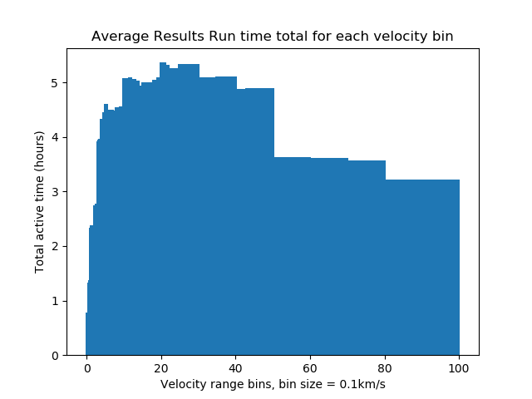
Chosen Approach
To calculate a rate of particles for a given set of parameters, all sessions that meet the session parameters are isolated.
A histogram is created, with velocity in km/s along the x axis. This allows us to sum our sessions and get accurate results for the total amount of time spend running between any two velocity values, with a resolution of our bin size, .1km/s

Slide 13
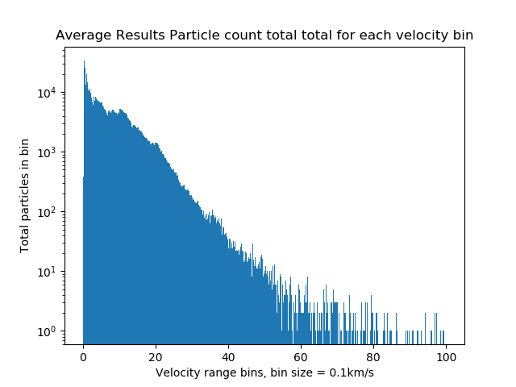
Chosen Approach
Another histogram is created to hold the distribution of the particles, again with bins of .1km/s.
The rate is then calculated with a third histogram, the particle distribution histogram divided by the run time histogram.

Slide 14
Other Information
Histogram bins are accurate to .1km/s
As of July 2019, fetched data is totaled at 32 MB ~ 15s on localhost database
Python requires installation of mysql.connector, which can be installed through the MySQL installer or pip.
Code and documentation is held in the Accelerator GitHub repo

Slide 15
Testing
All segments of the code were tested on
1: Small, self made data set for easy confirmation of function
2: Data from past 2 weeks, results confirmed with operators
3: All historic data, to check larger trends and dealing with problematic data
Each tagging and segmentation step was confirmed by cross-checking parallel but unused data, such as
Checking that observed particle velocity ranges matched the tags of the sessions
Tagged experiment IDs matched the experiment IDs stored for each dust event
Comparing estimated rates on previous runs

Slide 16
Optimal and Poor Results
There tends to be significant variation in the performance between sessions, so insights on variation of rate performance was necessary.
A “performance factor” is assigned to each session, which is how the session compares to the expected performance based on mean results.
Optimal Results are results taken from the sessions with 60th-90th percentile performance results, to avoid outliers.
Poor results are taken from the sessions with 10th-40th percentile performance results

Slide 17
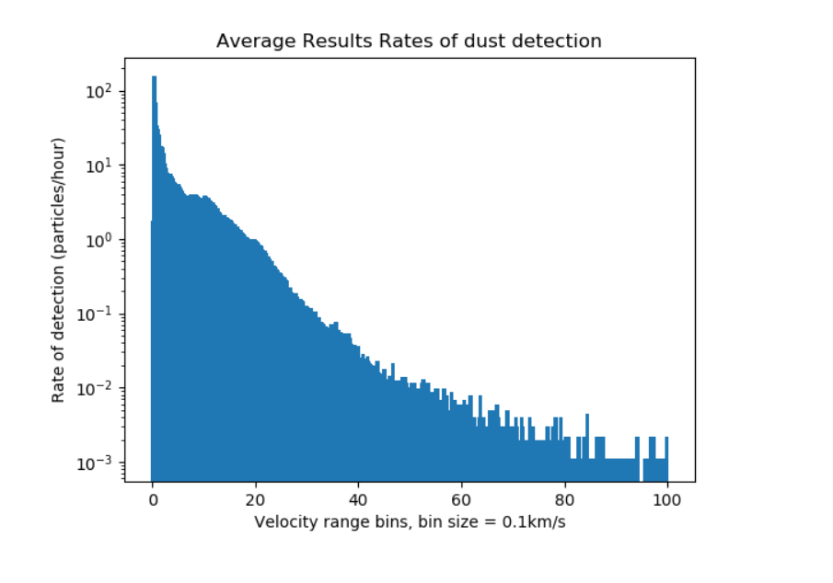
Performance Factor
For example, a session with the following characteristics is compared to the expected rate, and the performance factor is the rate, divided by the sum of the blue area between the lines
Session
445 dust events in 2 hours
5km/s – 30km/s
222.5 events/hour

Slide 18
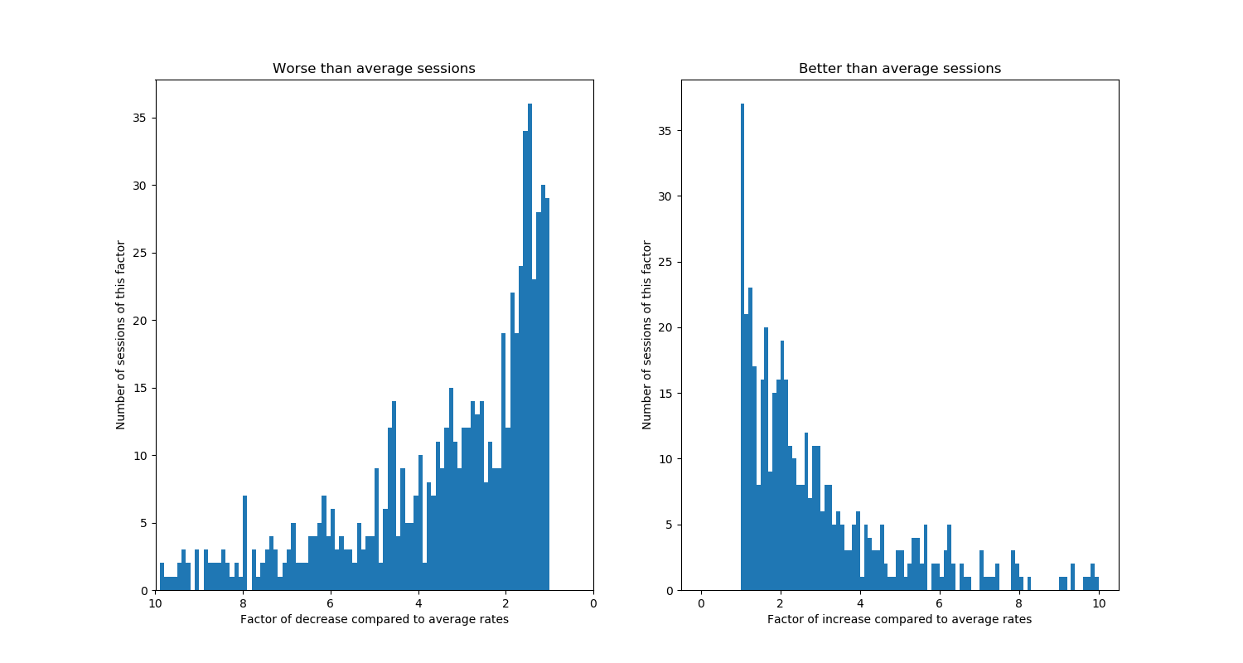
Performance Distribution

Slide 19
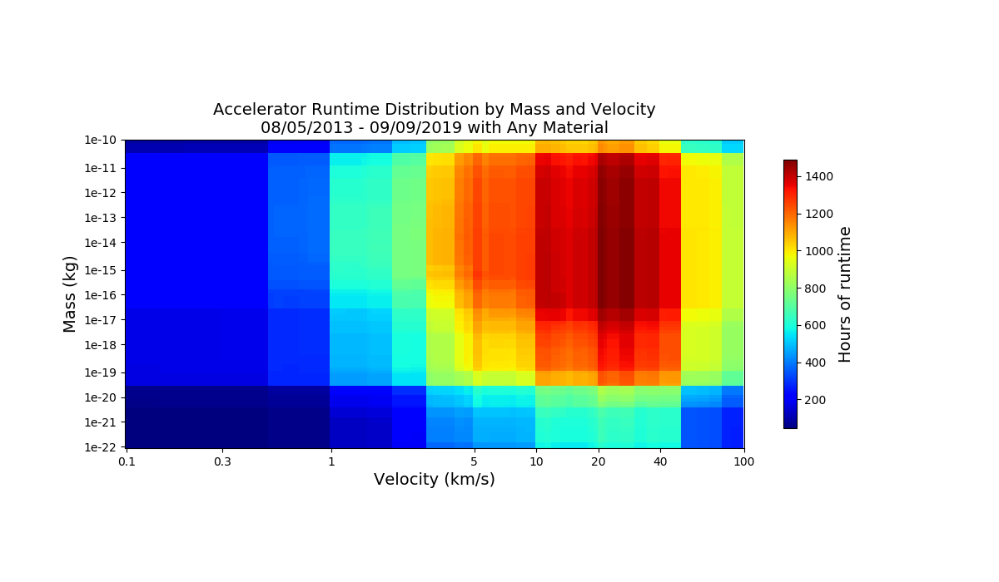

Slide 20
Heatmaps
The heatmaps are created in a similar fashion to the earlier histograms, now with mass parameters
Below are heatmaps for the runtime, particles, and rate. The particle and rate heatmaps are adjusted for their true bin size in (kg)(km/s)

Slide 21
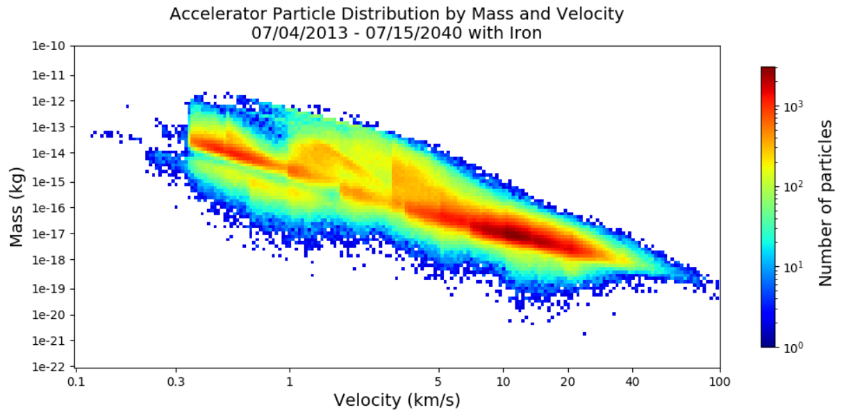

Slide 22
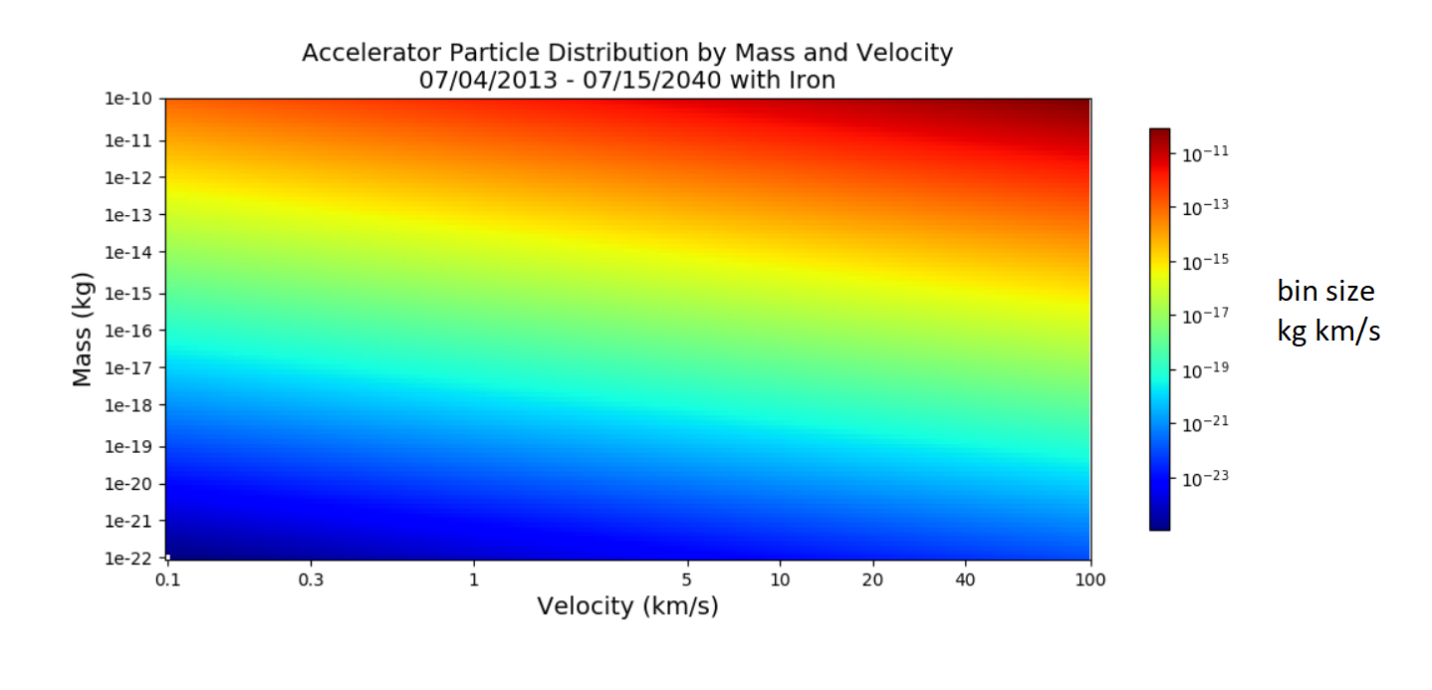

Slide 23
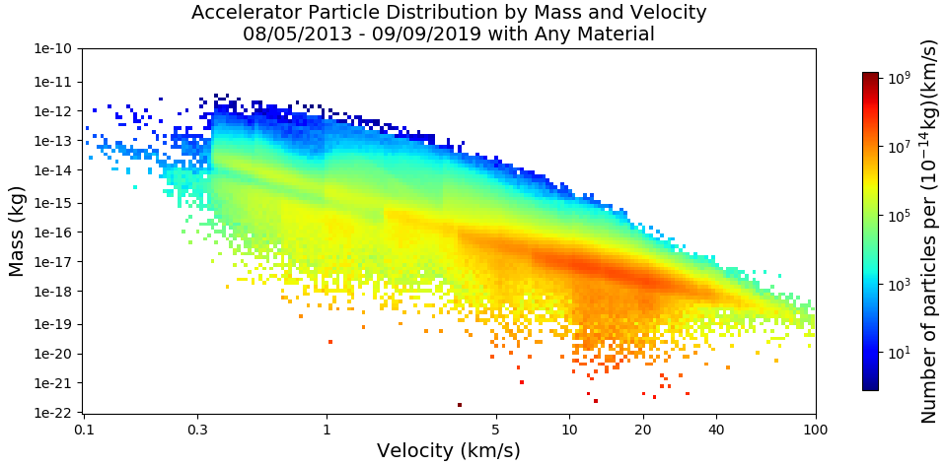

Slide 24
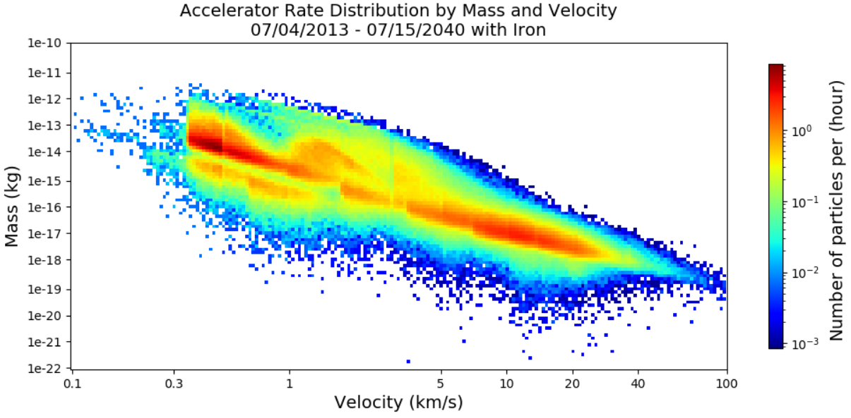

Slide 25
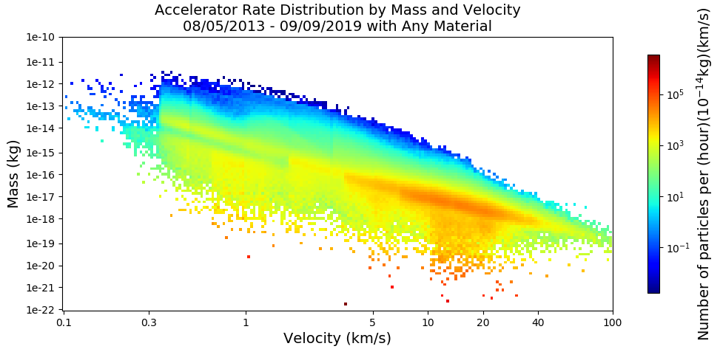

Slide 26
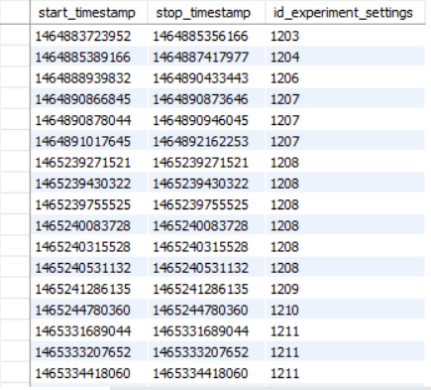
run_times Table Fix
Table incorrect due to a small change in LabVIEW code 6 June 2016, registering the start time twice
Included in the directory is a run_times table fixer, which retroactively changes the table to reflect the correct
Requires update for mySQL server
LabVIEW code has been corrected

